Slide 1
ITSC 203:
Offensive and Defensive Tool Construction
Module : Buffer Overflow Taxonomy
Notes:
1

Slide 2
Buffer Overflow
There are essentially 2 types of buffer overflow:
Heap and Stack
The stack is the area of memory used by a function to provide a scratch pad, that is temporary variables used during program execution. Also it is used for local variables and other values necessary for function operations.
The Heap is the area of memory that is provided on a as needed basis and most importantly the space is dynamically created.
The stack overflow is the most prevalent in terms of discussions around software vulnerabilities because of its ease to display and discuss. We will follow this recipe to give the reader a glimpse of what is possible.
It is suggested strongly that the reader continue their study and investigate the heap overflow exploit. Learn about malloc, calloc and free functions first.

Slide 3
Why we care
A Buffer is a small area of memory. An array is a classic example of a buffer used to explain the buffer and its exploitation ie “Buffer Overflow”.
…. any area of memory can be considered a buffer.
We care about these types of exploits because of the damage that can be accomplished by an adversary finding mistakes made during the Software Development Life Cycle (SDLC). This has been the case of many major attacks levied against an otherwise functioning program and eventually an enterprise.
To provide a sense of the extent to which this type of exploit has created and persists in creating problems for organization globally; peruse the following Wikipedia page: https://en.wikipedia.org/wiki/Buffer_overflow
As you analyze the following documentation think about how you can apply some of the concepts to:
Evaluate your environment for these problems
What skills are needed if you choose to go into penetration testing or vulnerability assessment.
What checklists can you create to help protect the infrastructure you will likely be tasked with protecting.

Slide 4
The Code
The following code is a simplistic example of how a buffer overflow can be introduced and eventually exploited. By looking at the program there doesn’t seem to be any issues from a casual glance. Make note of your initial assessment of the code and decide if you can find the issue(s) that could lead to an exploit.
#include<stdio.h>
#include<string.h>
int main()
{
char realpwd[] = "P@$$w0rd!";
char passwd[15]={'\0'};
printf("Please enter your password: ");
scanf(" %[^\n]s", passwd);
if( !strncasecmp(passwd, realpwd, 15))
printf("You entered the correct password!!!\nProceed!!!\n");
else
{
printf("Try again!!!\nYou entered an incorrect password!!!\n");
printf("realpwd: %s passwd: %s\n", realpwd, passwd);
}
}

Slide 5
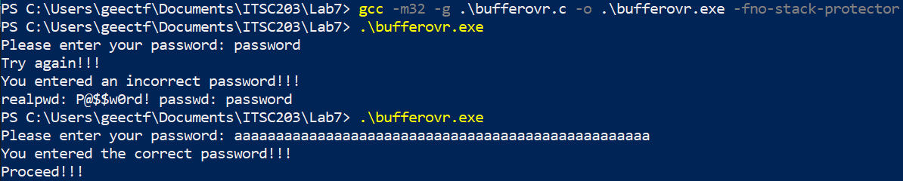
Program Execution
Follow the recipe below to create your program and test it to confirm the behavior as demonstrated.
A few things of importance:
Compile the program as a 32bit executable
Run the program and enter a password of “password” or any other string
Run the program again and this time enter a long string of a’s.
Try any letter you like as long as it is a sequence.
Question
Which pattern will not work and why?
123456123456123456
abcdefghijklmnopqrstuvwxyz
abcdefghijklmnopqrstuvwxyzabcdefghijklmnopqrstuvwxyz

Slide 6
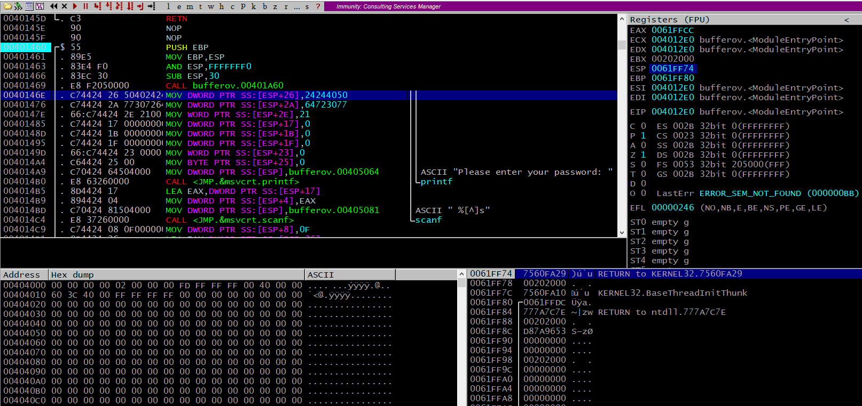
Why this behavior?
At this point the curious and the Explorer in you is wondering why is the program behaving this way…
Let’s get into weeds a bit and figure it out. To do so launch immunity and open your executable in the program:

Slide 7
Watch the video
I have attached a video called Buffer
Find the main function as describe in the video recording
Set a breakpoint at the first instruction of the prolog.
You must make note of the following as you watch the video:
The address of the main function
Make note of the address of ESP and the value on the stack at that location
What is that value?
Also make note of the address of ESP+4 and the value on the stack at that location
What is that value
After the program crashes observe the contents of EIP and the address of ESP and ESP+4. What can you conclude????
How did the return address get filled with the value 0x61616161? Is this a bad thing?
Can you articulate the effects of a buffer overflow?

